Slide 1

MAJOR PROJECT PRESENTATION
TECHNIQUE FOR SALMON FISH DISEASE DETECTION USING HYBRID MODEL IN DEEP LEARNING
PRESENTATION BY:-
Name: KESHAV ABHISHEK
Registration No. 2201020582
Guided By:
Name: AMAN KUMAR
Registration No. 2201020583
Prof.(Dr.) Sukant Kishoro Bisoy
Dept. of Computer Science & Engineering

Slide 2
OUTLINE
Introduction
Technical Details
Tech Stack
Test Bed Preparation & Quality Assurance Strategy
Website Interface
Conclusion & Project Outlook
References

Slide 3
INTRODUCTION
Fish quality plays a crucial role in ensuring food safety and maintaining standards in aquaculture. Traditionally, the identification of fresh and infected fish is performed through manual inspection, which is often time-consuming, error-prone, and highly subjective. To address this challenge, our project focuses on developing an automated image classification system capable of distinguishing between fresh fish and infected fish. We utilized deep learning models such as CNN, ResNet50, and a Hybrid CNN+ResNet50 approach, along with traditional machine learning models including SVM, Random Forest, Decision Tree, Logistic Regression, and KNN, to evaluate their performance on the dataset. Through extensive experimentation and augmentation of the dataset, our models achieved very high accuracy, with the Hybrid CNN+ResNet50 reaching above 99%. This demonstrates the potential of deep learning-based solutions to support real-world applications in fish markets and aquaculture farms for efficient and reliable quality detection.

Slide 4
TECHNICAL DETAILS
DATASET:
The dataset consists of two categories:
Fresh Fish → 456 images
Infected Fish → 752 images
Total Images: ~1,208
All images were standardized to 224 x 224 pixels.
DATA AUGMENTATION:
To improve model generalization and prevent overfitting, data augmentation was applied using the Albumentations library.
Augmentation techniques used:
Horizontal Flip; Vertical Flip
Random Brightness & Contrast adjustment
Rotation (up to 30°)
Shift, Scale & Rotate
Gaussian Noise addition
Blurring
The dataset was expanded from its original size to approximately 13,520 images in total.
Images were divided into two categories: Fresh Fish, Infected Fish
All augmented images were saved in a structured format for training.

Slide 5
TECHNICAL DETAILS
Model Implementation:
Convolutional Neural Network (CNN)
Built a custom CNN architecture for classifying Fresh vs. Infected Fish.
Applied convolution, pooling, and fully connected layers for feature extraction and classification.
Achieved 97.34% accuracy with strong precision and recall.
ResNet50 (Transfer Learning)
Leveraged ResNet50, a pre-trained deep learning model, for feature extraction.
Fine-tuned the model on the fish dataset.
Achieved 99.34% accuracy with very high precision and F1-score.
Proposed Model:( Hybrid (CNN + ResNet50))
Used image features to train.
Accuracy reached around 99.73% accuracy, 99.01% recall and 99.00 of F1-score.
Other Machine Learning Models
Implemented traditional ML algorithms like Random Forest, Decision Tree, Logistic Regression, and KNN.
Performance was moderate (Accuracy: 80–87% range).
Showed that classical ML models are not as effective for complex image classification.

Slide 6
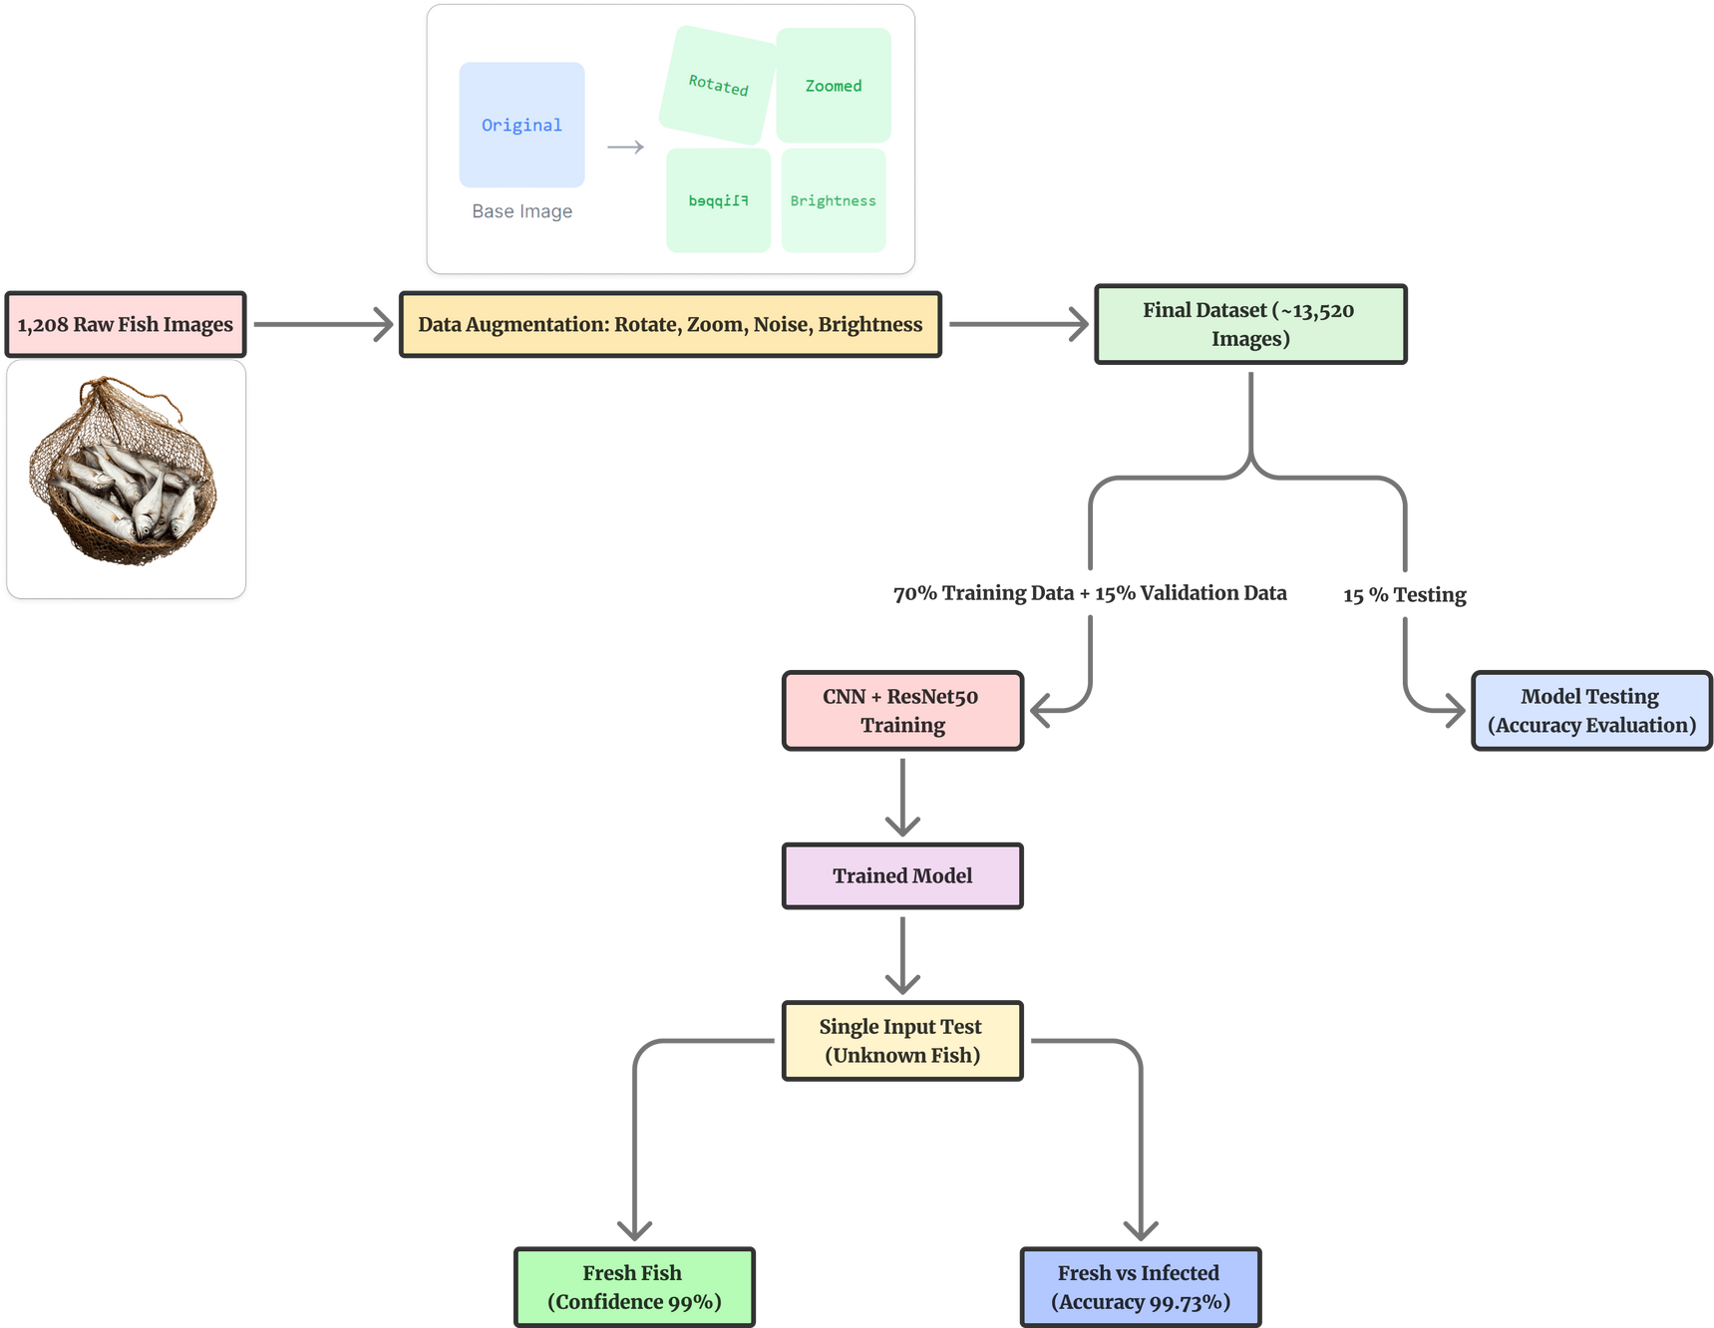
TECHNICAL DETAILS

Slide 7
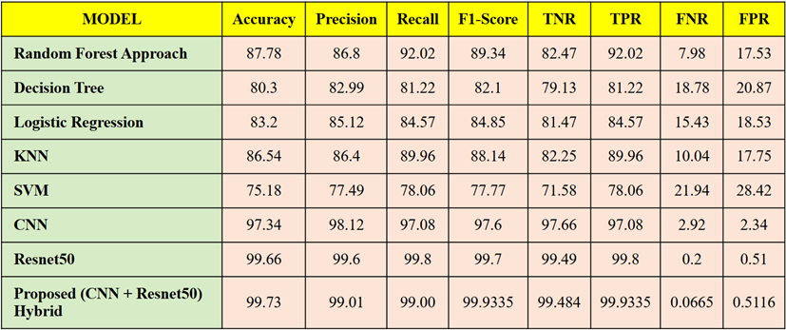
Models
Model Comparision

Slide 8
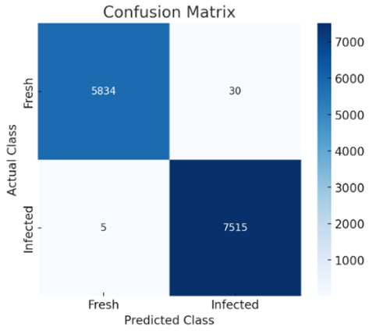
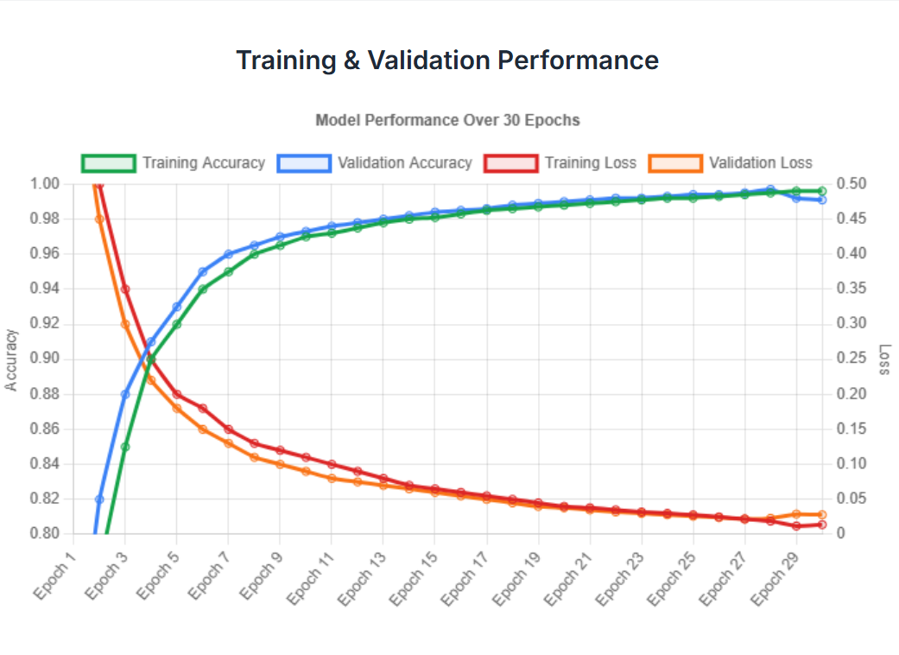
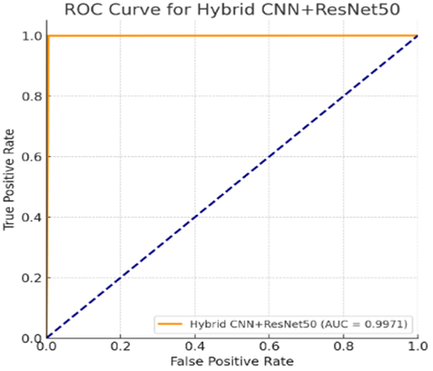
Result & Analysis

Slide 9

Test Bed Preparation & Quality Assurance Strategy
Hybrid CNN-ResNet-50 Architecture:
Architecture: Custom Hybrid CNN built using ResNet-50 as a base model for robust feature extraction.
Platform: Testing performed on a dedicated high-performance computing instance for consistent inference.
Rigorous Validation Strategy:
Validation leveraged the entire 13,520-image validation dataset to ensure the model's generalized performance across both classes:
Diverse Sample Set: Included 7,520 InfectedFish (True Positives) and 6,000 FreshFish (True Negatives).
Verification: Model efficacy was proven by analyzing performance metrics derived from predicted probabilities.

Slide 10

TECH STACK
Core Tech Stack
Programming Language: Python
Deep Learning Framework: TensorFlow and Keras (tf.keras)
Utility: PIL library of python used for data augmentation (image)
Frontend Tech Stack
HTML
Css
Javascripts
Backend Tech Stack
Flask - A python framework to interact with backend and frontend of the app and website

Slide 11
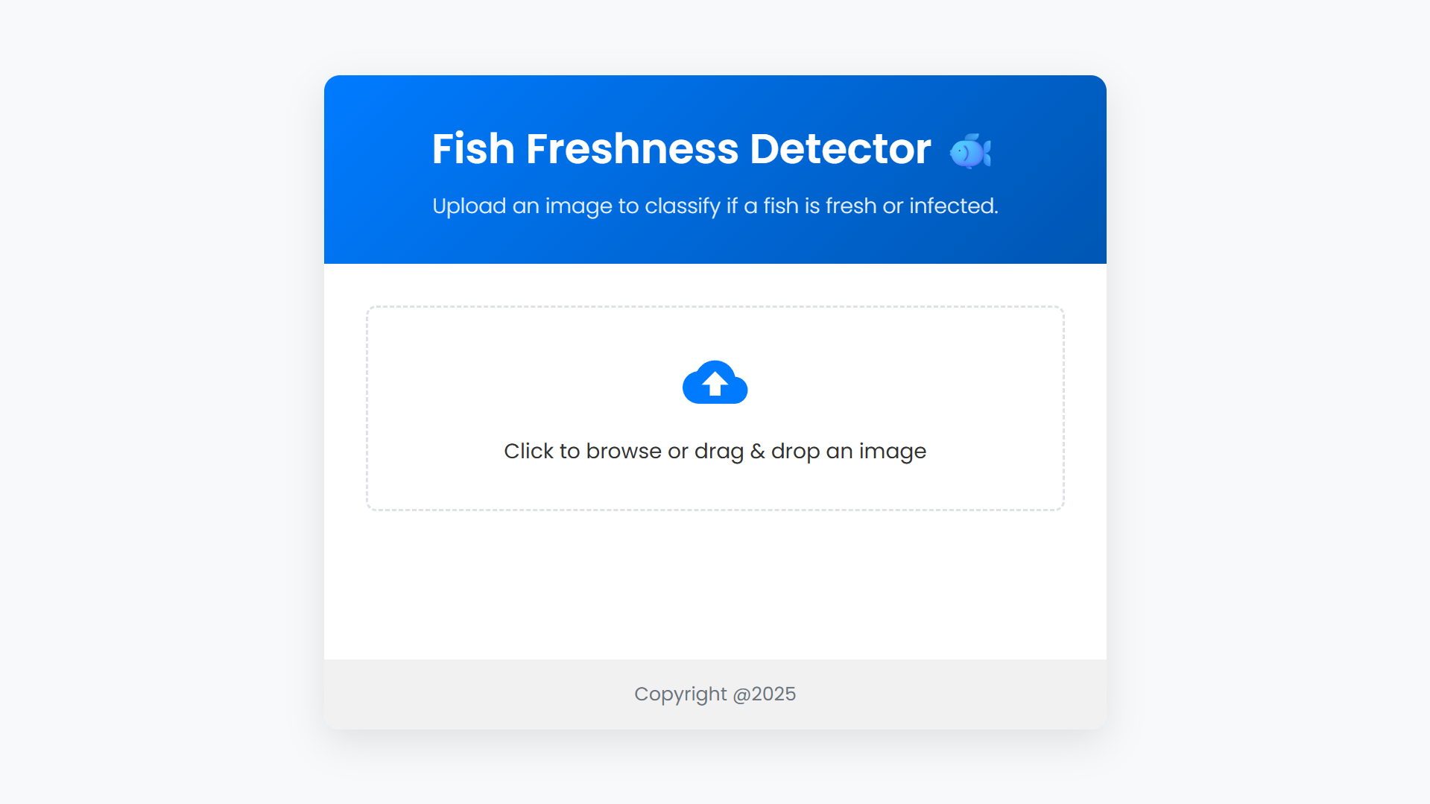
Website Interface
Home Page

Slide 12
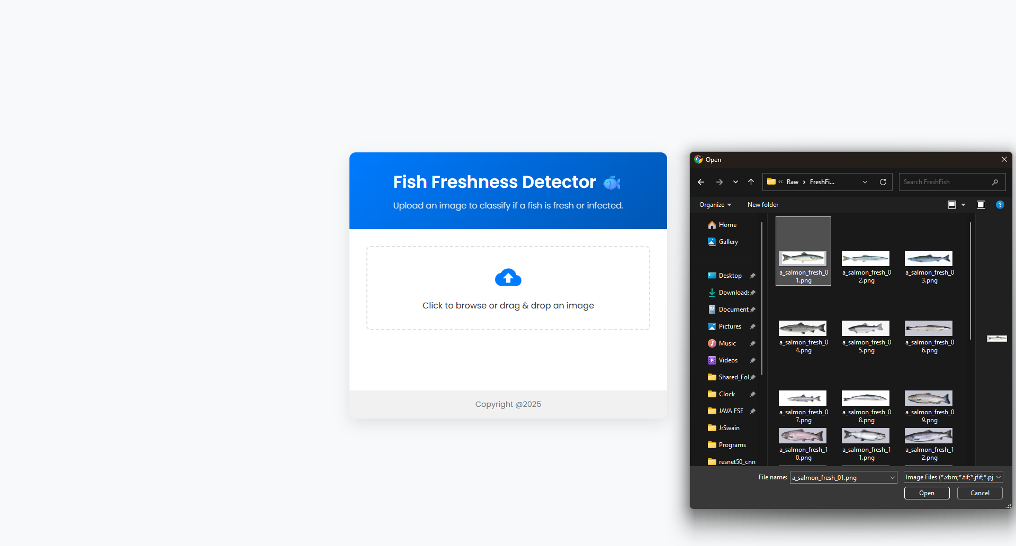
Website Interface
File Selection

Slide 13
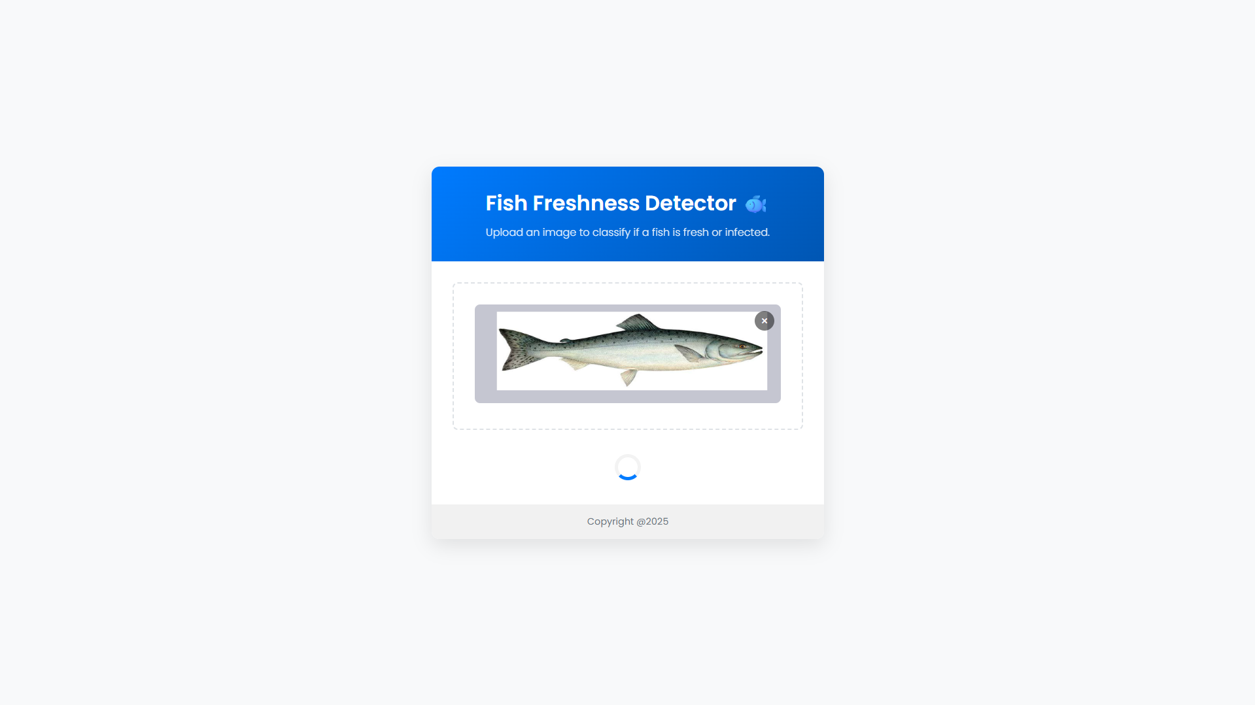
Website Interface
Processing using trained model

Slide 14

Website Interface
Result (output)

Slide 15
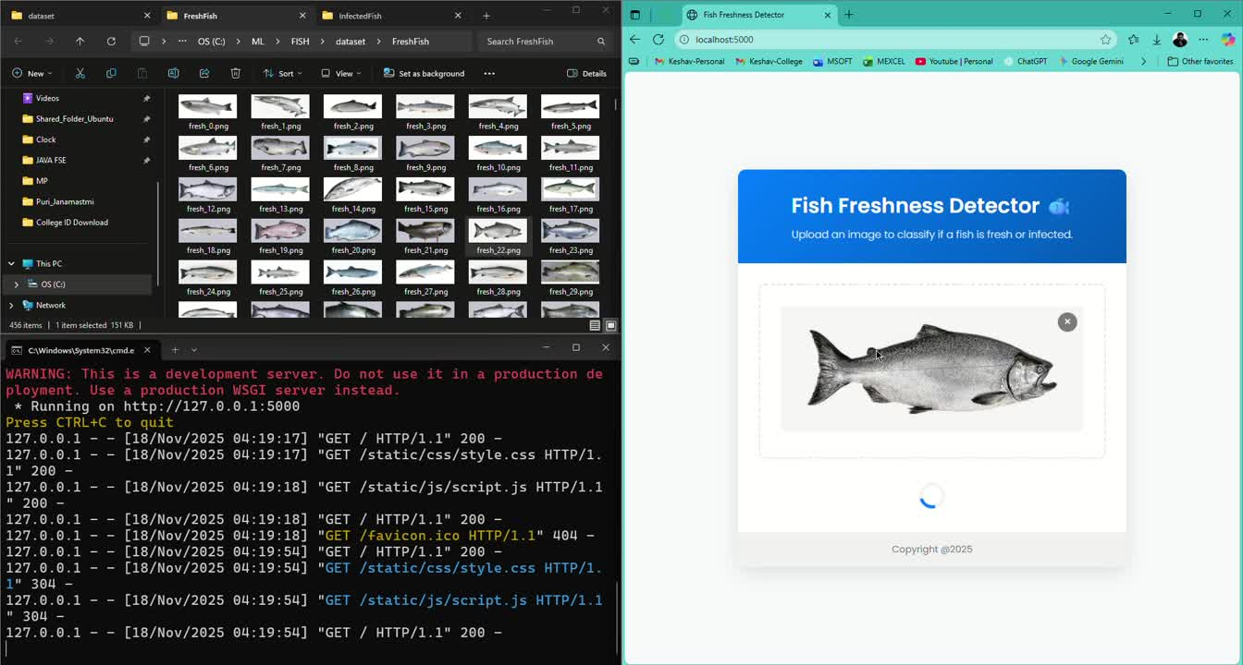

Slide 16
CONCLUSION & PROJECT OUTLOOK
Core Findings: Deep Learning Validation
DL Superiority: Deep Learning (CNN/ResNet50) decisively outperformed traditional ML (RF, SVM, etc.) for complex fish image classification.
Transfer Learning Value: ResNet50 proved critical, validating Transfer Learning as essential for achieving superior generalization and robust feature extraction.
Hybrid Model Performance Summary
Architecture: Hybrid CNN-ResNet50 model utilizing a 13,520-image.
Key Results (Proven Competence):
Accuracy:99.73%
AUC:0.9998
Recall (Infected Detection):99.93%
Reliability demonstrated by robust discrimination and low false-positive rate.
Impact & Next Steps:
Project Impact: This work validates deep learning for modern aquaculture, opening doors for real-time fish health monitoring and food quality assurance.
Future Work: Developing a lightweight, deployable application for practical field integration of the Hybrid Model.
We are now preparing for getting this paper published into known publications.

Slide 17
References
Aditya Rajbongshi, Rashiduzzaman Shakil, Bonna Akter, Munira Akter Lata, Md. Mahbubul Alam Joarder,“A comprehensive analysis of feature ranking-based fish disease recognition”, Array, Volume 21, 2024, 100329, ISSN 2590-0056, https://doi.org/10.1016/j.array.2023.100329. (https://www.sciencedirect.com/science/article/pii/S2590005623000541)
Md Shoaib Ahmed, Tanjim Taharat Aurpa, Md. Abul Kalam Azad, “Fish Disease Detection Using Image Based Machine Learning Technique in Aquaculture”, Journal of King Saud University - Computer and Information Sciences, Volume 34, Issue 8, Part A, 2022, Pages 5170-5182, ISSN 1319-1578, https://doi.org/10.1016/j.jksuci.2021.05.003.(https://www.sciencedirect.com/science/article/pii/S1319157821001063)
Md Shoaib Ahmed, Samiha Maisha Jeba, “Salmon Scan: A novel image dataset for machine learning and deep learning analysis in fish disease detection in aquaculture”, Data in Brief, Volume 54, 2024, 110388, ISSN 2352-3409, https://doi.org/10.1016/j.dib.2024.110388. (https://www.sciencedirect.com/science/article/pii/S2352340924003573)

Slide 18
THANK YOU

